Slide 1

Customer Retention Analysis
For :- Indian
E-Commerce Websites

Slide 2
Introduction
Customer satisfaction has emerged as one of the most important factors that guarantee the success of online store; it has been posited as a key stimulant of purchase, repurchase intentions and customer loyalty. A comprehensive review of the literature, theories and models have been carried out to propose the models for customer activation and customer retention. Five major factors that contributed to the success of an e-commerce store have been identified as: service quality, system quality, information quality, trust and net benefit. The research furthermore investigated the factors that influence the online customers repeat purchase intention. The combination of both utilitarian value and hedonistic values are needed to affect the repeat purchase intention (loyalty) positively. The data is collected from the Indian online shoppers. Results indicate the e-retail success factors, which are very much critical for customer satisfaction.

Slide 3
Contents :-
Problem Statement
Customer Retention and its benefits
Reasons why retention is the foundation of customer growth
How to Retain Customer’s ?
Problem Understanding
Exploratory Data Analysis
Graphical Visualization
Analyzation
Assumptions
Conclusion
Drawbacks and Scope for the Future work

Slide 4
Problem Statement
Customer satisfaction has emerged as one of the most important factors that guarantee the success of online store; it has been posited as a key stimulant of purchase, repurchase intentions and customer loyalty. A comprehensive review of the literature, theories and models have been carried out to propose the models for customer activation and customer retention. Five major factors that contributed to the success of an e-commerce store have been identified as: service quality, system quality, information quality, trust and net benefit. The research furthermore investigated the factors that influence the online customers repeat purchase intention. The combination of both utilitarian value and hedonistic values are needed to affect the repeat purchase intention (loyalty) positively.

Slide 5
Customer Retention and It’s Benefits
Customer retention refers to the activities and actions companies and organizations take to reduce the number of customer defections.
It is important to remember that customer retention begins with the first contact a customer has with a company and continues throughout the entire lifetime of the relationship
There are a number of actions and activities certain companies take to reduce churn and increase customer retention.
Focusing on customer retention is important because it not only looks at how good a company is at acquiring new customers but also how good they are at keeping those customers. While you may have the best acquisition process in the business, if your retention is terrible then it’s all worthless

Slide 6

Benefits
Retention is Cheaper than Acquisition
Loyal Customers are More Profitable
You’ll Earn More Word of Mouth Referrals
Customers Will Explore Your Brand
Loyal Customers are More Forgiving
Customers Will Welcome Your Marketing
You Earn Wiggle Room to Try New Things

Slide 7
Reason why Retention is the Foundation of the Customer Growth
There are 5 reasons to know that why “Retention” is the foundation of customer growth ?
Improve ROI
Convert more sales
Spend less on TOFU marketing
Increase customer LTV
Earn more referrals

Slide 8
How to Retain Customer’s?
Recruit the right customers to begin with
Once you have them, segment them by lifetime value
Communicate with them to build loyalty

Slide 9
Problem Understanding
Customer retention means the process of maintaining or keeping customers once you have acquired them. It’s all the activities that a company must do in order to keep their customers around. The goal is to build a long-lasting relationship between the brand and consumers. Once a customer becomes loyal to your brand, not only he will buy more from you than a normal customer but he’ll spread good words about your business, increase your reputation. Here we have to analyse the affect of different feature on customer retention.

Slide 10
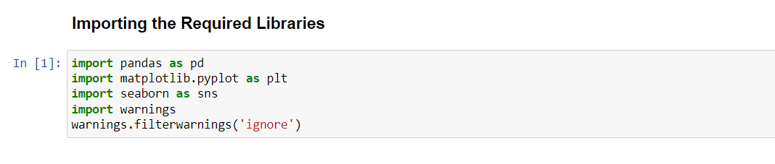
Exploratory Data Analysis
Here At the Very Starting I have Imported the required Libraries.

Slide 11
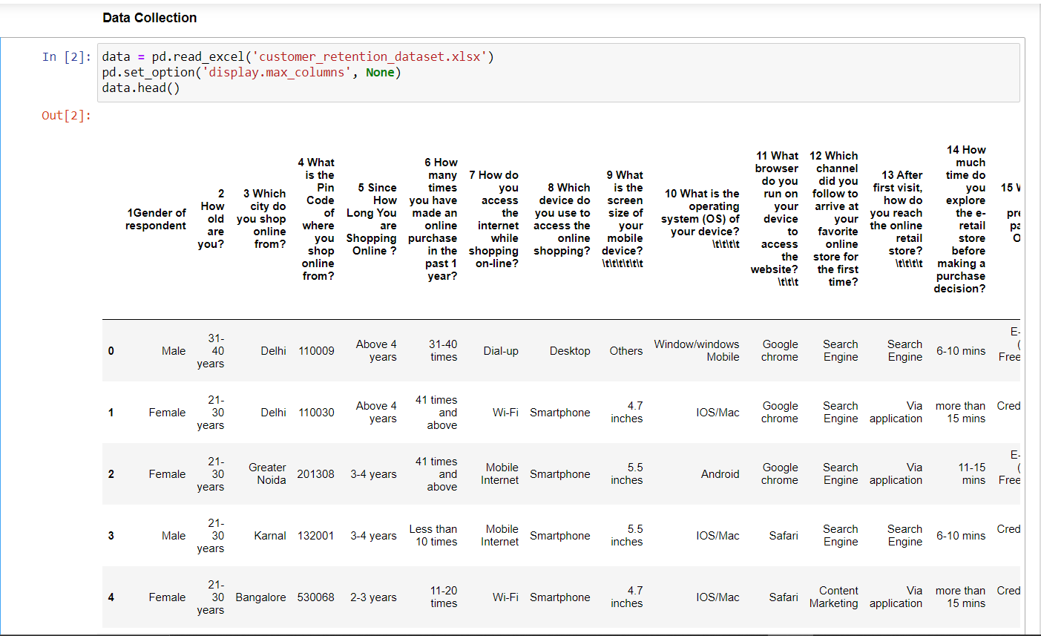
Exploratory Data Analysis

Slide 12
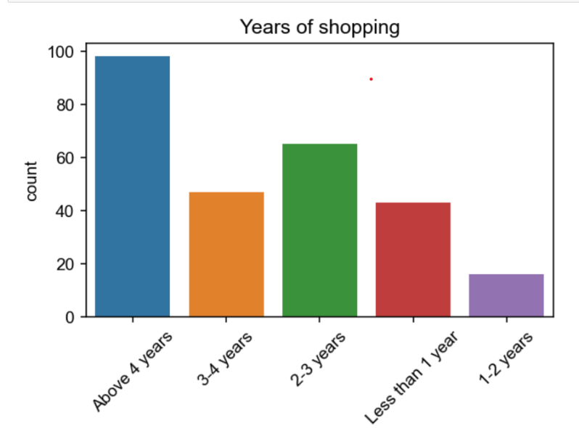
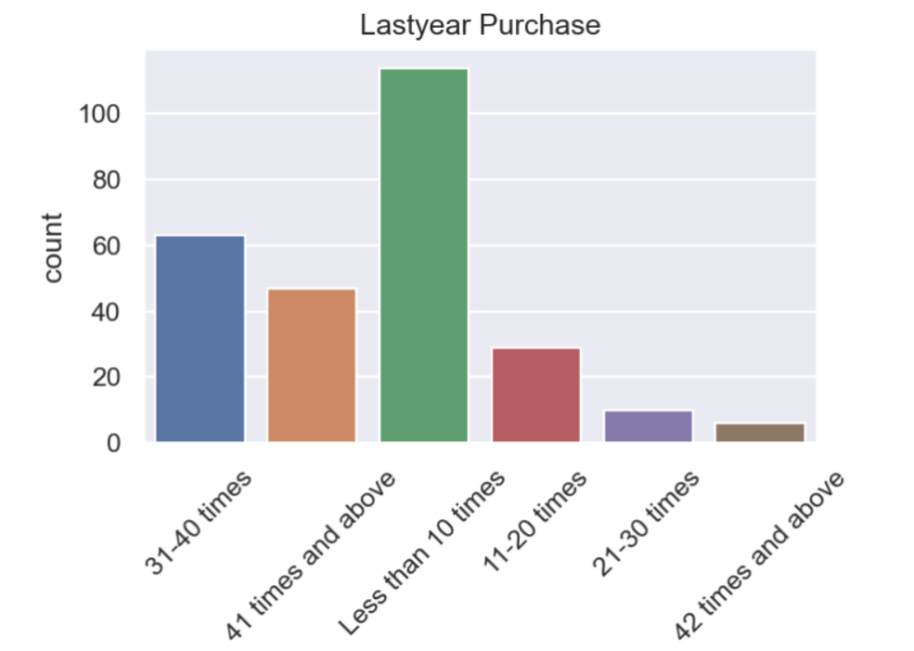
Graphical Visualization
Univariate Analysis :-

Slide 13
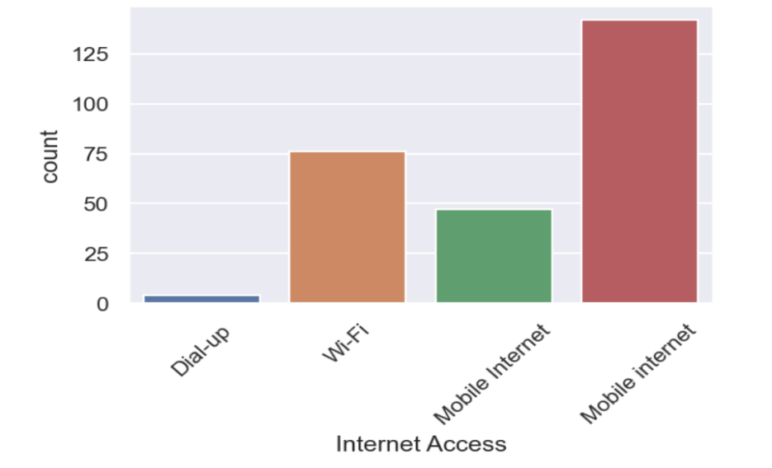
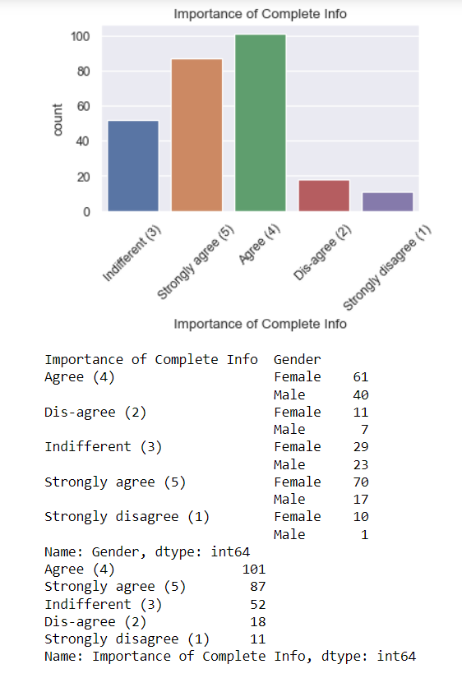
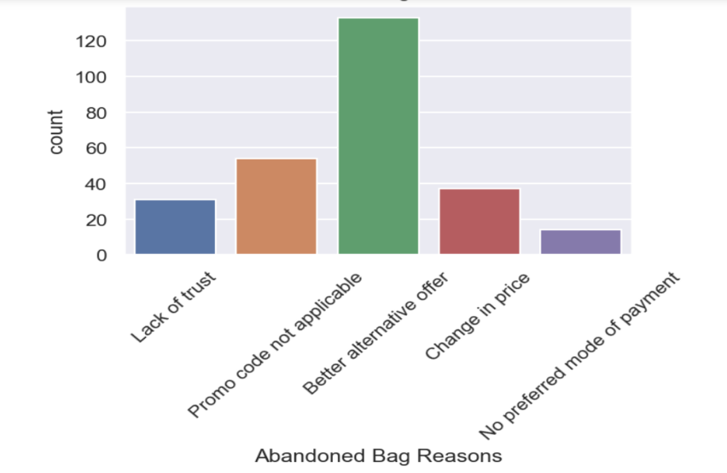
Univariate Analysis :-

Slide 14
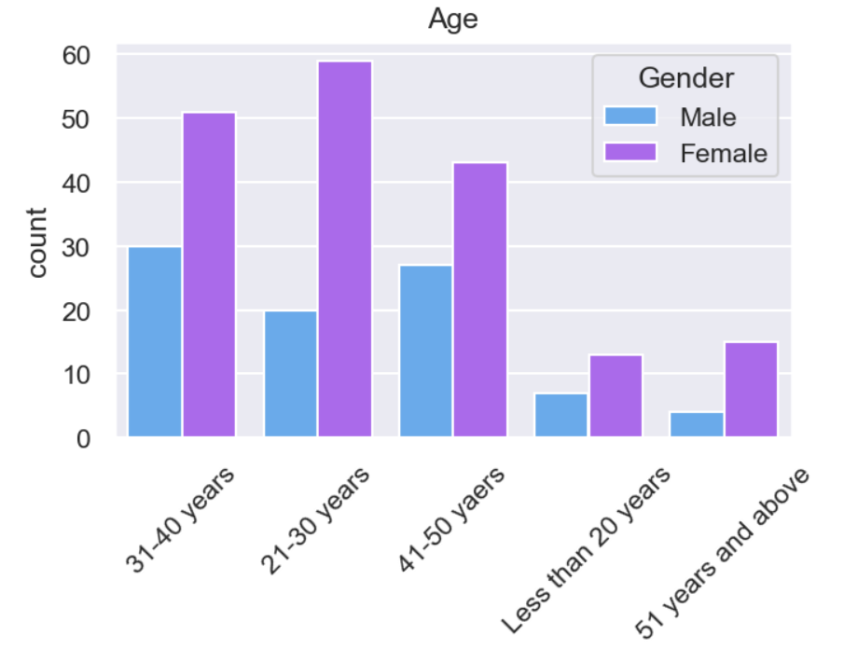
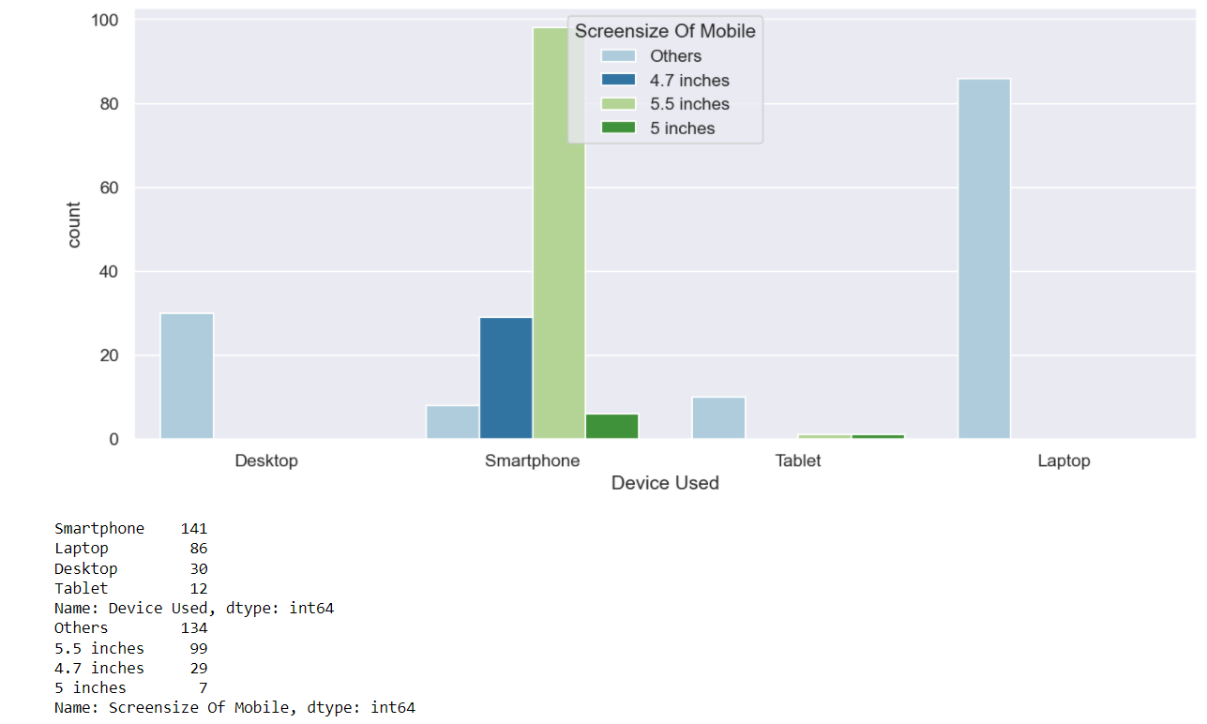
Bivariate Analysis :-

Slide 15
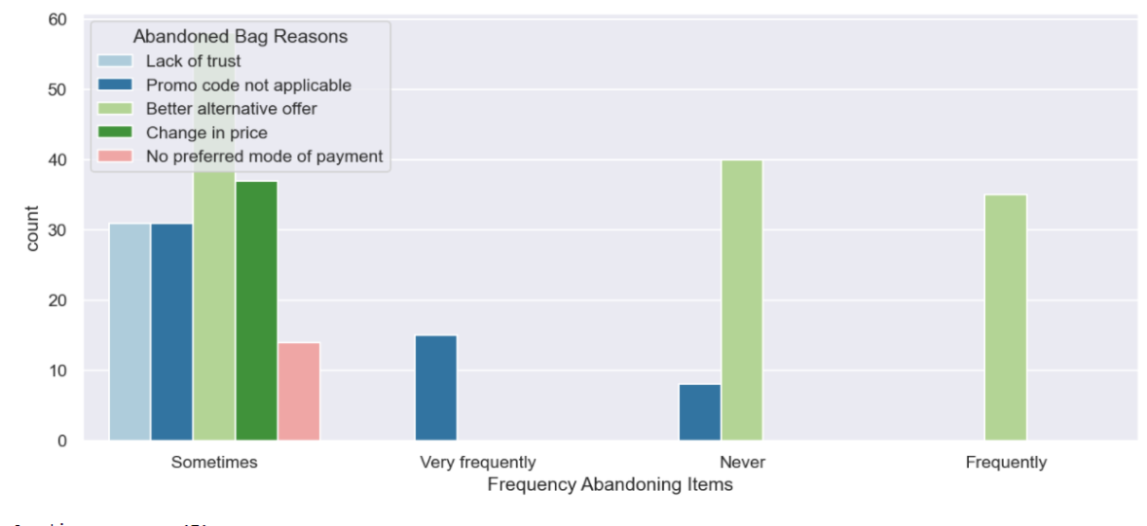
Bivariate Analysis :-

Slide 16
Assumptions
Initially we assumed that customers recommend e-commerce websites to their friends, if they are satisfied with the service and they are frequently using the websites for online shopping.
In order to prove that the customer expectations on a e-commerce website should influence the websites they recommend to their friends.
This implies that the websites recommended to their friends should meet the customer expectation and it is highly likely to be re-visited by the buyers for future purchases.
This hypothesis proves that the buyer who recommends a e-commerce site to a friend is the retained buyer of the respective e-commerce companies.

Slide 17
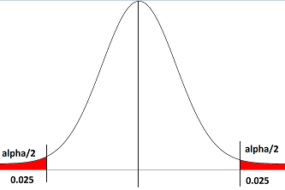
Assumptions
Here in order to prove the correlation between the customer expectation and the website recommendation to a friend, we have used chi-squared test
The alpha value assumed was 0.05 (5%) and we have to find the p-value for each customer expectation variables
Null Hypothesis (Ho) was that the customer expectation variable has no relation with the website recommendation to a friend (p > alpha)
Alternate Hypothesis (Ha) was that the customer expectation variable influences the website recommendation to a friend (p < alpha)

Slide 18
Conclusion
Retention analysis is an integral part of your customer retention and marketing strategies. By taking full advantage of the data you collect by tracking customer behaviour, requesting feedback, and studying important metrics, you can decrease the churn rate, improve customer satisfaction, and boost your revenue.
I found Amazon and Flip kart are standing best out in the market by using ethical, reasonable business strategies.
When customers are satisfied with a company or service, there is a high possibility that they will share their experience with other people Therefore it is crucial for E-commerce to take into account their customer satisfaction because this will retain customer loyalty as well as attract potential customers

Slide 19
Conclusion
Frequency of Females shopping is high so making them satisfied will help the sellers to get more business.
Loyal customers prefer buying and tend to spend more money on shopping in your store. Statistics show that engaged consumers purchase more frequently. It is necessary to hear customer feedback because most of them are valuable feedbacks.
Here as an conclusion part I found that using dead old strategies for retailers will effect customer retention.
Organisation will always focus on success for that keeping the old customers will always be a plus point.
Also Paytm and Snap deal has maximum drawbacks it is because of their dead old strategies.

Slide 20
Drawbacks and Scope
for the Future Work
We are able to properly analyse the valuable feedback of the customers but given, the dataset was very small as it may result in bias understanding. If we are able to increase the feedbacks from more customers all over it would provide a great understanding of the strategies we will have to use to improve customer retention.
The data used to analyse the customer retention was very less.
The answers towards the e-commerce sites were combination of two or more e-commerce sites, the survey answers should have been limited to maximum 2 websites in order to understand the retention rates better.

Slide 21


Submitted By :- Ojasav Sahu
Internship :-
23

